Slide 1
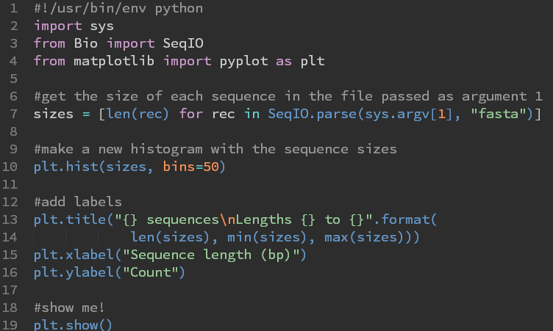
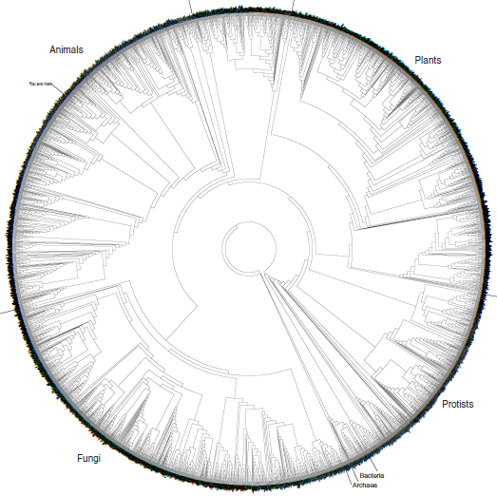
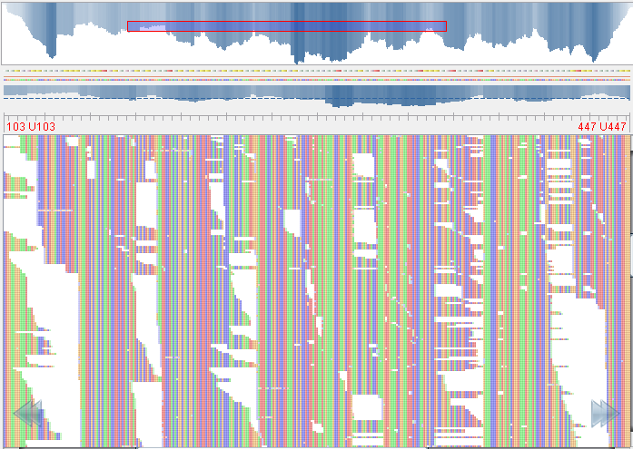
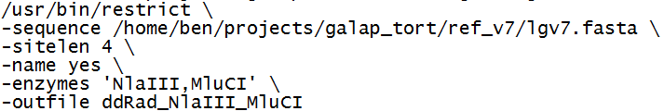
“Hands On”
Bioinformatics

Slide 2
Easy, right?

Slide 3
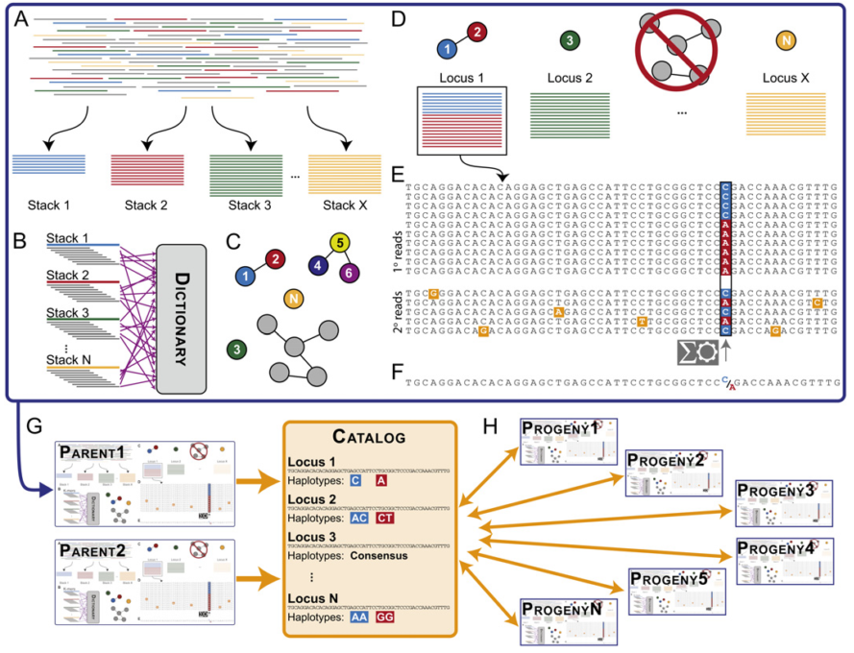
Easy, right?

Slide 4
What now?
Some file format explanations
How to get software
‘Installing’ software
Quality Control
Mapping to a reference
Alignments
Variant calling
Stacks
Some more demos
ddRAD in silico?
De novo sequencing?
rtd?
Notes:
bowtie2 --local -x ref -U name.fastq | samtools view -Su - | samtools sort - name && samtools index name.bam && samtools idxstats name.bam > name.alnstats
samtools mpileup -uID –Q 20 -f ref.fa aln1.bam aln2.bam | bcftools view -vcg - > var.raw.vcf

Slide 5

Data File Formats
Formats
fastQ
Sam Bam
VCF
BED

Slide 6
fastQ files
Quadruplets, sometimes paired.
@SEQ_ID
GATTTGGGGTTCAAAGCAGTATCGAT
+
!''*((((***+))%%%++)(%%%%)
See: http://en.wikipedia.org/wiki/FASTQ_format

Slide 7
fastQ files
Often now come as gzipped chunks
To make computer and administrators happy
$ gunzip –c *.fastq.gz > all.fq
$ gunzip –c *R1*.fastq.gz > all_R1.fq

Slide 8
Sam/bam
Sequence Alignment Map / binary format
TAB-delimited
header lines start with @
Col | Field | Description
1 | QNAME | Query template/pair NAME
2 | FLAG | bitwise FLAG
3 | RNAME | Reference sequence NAME
4 | POS | 1-based leftmost POSition/coordinate of clipped sequence
5 | MAPQ | MAPping Quality (Phred-scaled)
6 | CIAGR | extended CIGAR string
7 | MRNM | Mate Reference sequence NaMe (‘=’ if same as RNAME)
8 | MPOS | 1-based Mate POSistion
9 | TLEN | inferred Template LENgth (insert size)
10 | SEQ | query SEQuence on the same strand as the reference
11 | QUAL | query QUALity (ASCII-33 gives the Phred base quality)
12+ | OPT | variable OPTional fields in the format TAG:VTYPE:VALUE
See: http://samtools.sourceforge.net/samtools.shtml

Slide 9
VCF format: variants
Variant Call Format (origins 1k genomes)
TAB-delimited
Header lines start with ##
Column ID line starts with #
Col | Field | Description
1 | CHROM | CHROMosome name
2 | POS | the left-most POSition of the variant
3 | ID | unique variant IDentifier
4 | REF | the REFerence allele
5 | ALT | the ALTernate allele(s), separated by comma
6 | QUAL | variant/reference QUALity
7 | FILTER | FILTers applied
8 | INFO | INFOrmation related to the variant, separated by semi-colon
9 | FORMAT | FORMAT of the genotype fields, separated by colon (optional)
10+ | SAMPLE | SAMPLE genotypes and per-sample information (optional)
See: http://vcftools.sourceforge.net/

Slide 10
Bed files: intervals
Sequence Alignment Map / binary format
TAB-delimited
First 100bp: chromStart=0, chromEnd=100 [0,100)
Only require first 3 fields
Col | Field | Description
1 | chrom | Name of the chromosome or scaffold
2 | chromStart | Starting position of the feature, 0-based
3 | chromEnd | Ending position of the feature, not included in feature
4 | name | Defines the name of the BED line
5 | score | A score between 0 and 1000
6 | strand | Defines the strand - either '+' or '-'
7 | thickStart | Starting position at which the feature is drawn thickly
8 | thickEnd | Ending position at which the feature is drawn thickly
9 | itemRgb | RGB value of the form R,G,B 0-255
10 | blockCount | The number of blocks (exons)
11 | blockSizes | comma-separated list of the block sizes
12 | blockStarts | comma-separated list of block starts
See: https://genome.ucsc.edu/FAQ/FAQformat.html#format1

Slide 11

How to get/install things
Download
Compile?
PATH variable
Saving your PATH
Software
Extract

Slide 12
From the Cloud!!
Command-line downloading
wget or curl
$ wget http://sourceforge.net/projects/samtools/files/samtools/0.1.19/samtools-0.1.19.tar.bz2/download

Slide 13
Secure copy
Copy between computers
$ scp from to
#remote to local
$ scp ben@computer:/path/to/file ./
#local to remote
$ scp ./file ben@computer:/path/to/

Slide 14
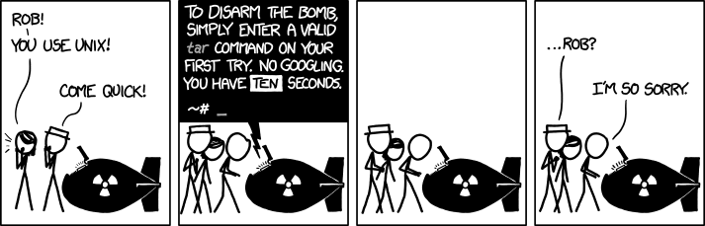
tar, gunzip, unzip
tar.gz/bz2, .gz, .zip
$ tar xf samtools-0.1.19.tar.bz2
x -> eXpand
f -> work on a File
v -> Verbose output
j/z -> j=bzip2, z=gzipped

Slide 15
“Installing”
Usually, our academic kin provide sparse documentation and some source code
Lucky: executable is pre-compiled
Annoying: examine readme or install file documentation
$ ./configure
$ make
#if you are an admin
$ sudo make install
#if you’re not…

Slide 16
Your $PATH
Special variable in your shell that keeps track of where to look for programs
OSX, Windows, Unix all use a PATH
$ echo $PATH
Moving an executable into one of these directories will make it available

Slide 17
.bashrc
A special file, run every time your shell starts
Can set environmental variables, define aliases, etc
To add your own directory to your path:
export PATH=/home/ben/bin:$PATH

Slide 18
Workflows
Quality Control
fastqc
fastx
De-multiplexing
Mapping to Reference
bowtie2 samtools
deduping and picard
Viewing alignments
Variant Calling
vcftools
samtools
phasing
extractHAIRS
HAPCUT
stacks
In silico digesting
running stacks
viewing results
Pre-process

Slide 19
Quality Control
Surveying sequencing success with fastqc
$ fastqc --noextract -t 4 s_2_sequence.txt
$ fastqc --noextract -t 4 *R1*.fastq.gz
example
http://www.bioinformatics.babraham.ac.uk/projects/fastqc/

Slide 20
fastx
if you are using PHRED+33 encoded fastq, use -Q33
Keep reads where 80% are >=Q20:
$ fastq_quality_filter -Q33 -i fastq1.fastq -q 20 -p 80 -o quality_filtered.fastq
http://hannonlab.cshl.edu/fastx_toolkit/download.html

Slide 21
Demultiplexing
Your sequencing center can usually do this for you (unless you used custom barcodes)
Stacks’ process_radtags and process_shortreads
http://creskolab.uoregon.edu/stacks/comp/process_radtags.php

Slide 22
Mapping reads to a reference
Many many short read mappers
We’ll use bowtie2
Index reference genome
Map reads to genome
Sort bam file
Index bam file
De-dupe bam file
http://bowtie-bio.sourceforge.net/bowtie2/index.shtml http://samtools.sourceforge.net/

Slide 23
Mapping reads to a reference
Index:
$ bowtie2-build ref.fasta ref
Align & produce bam file:
$ bowtie2 -x path/to/ref -U sequences/fastq1.fastq | samtools view -Shu - | samtools sort - sample1
$ samtools index sample1.bam
S = sam file input
h = include header info
u = output uncompressed bam (faster pipes)

Slide 24
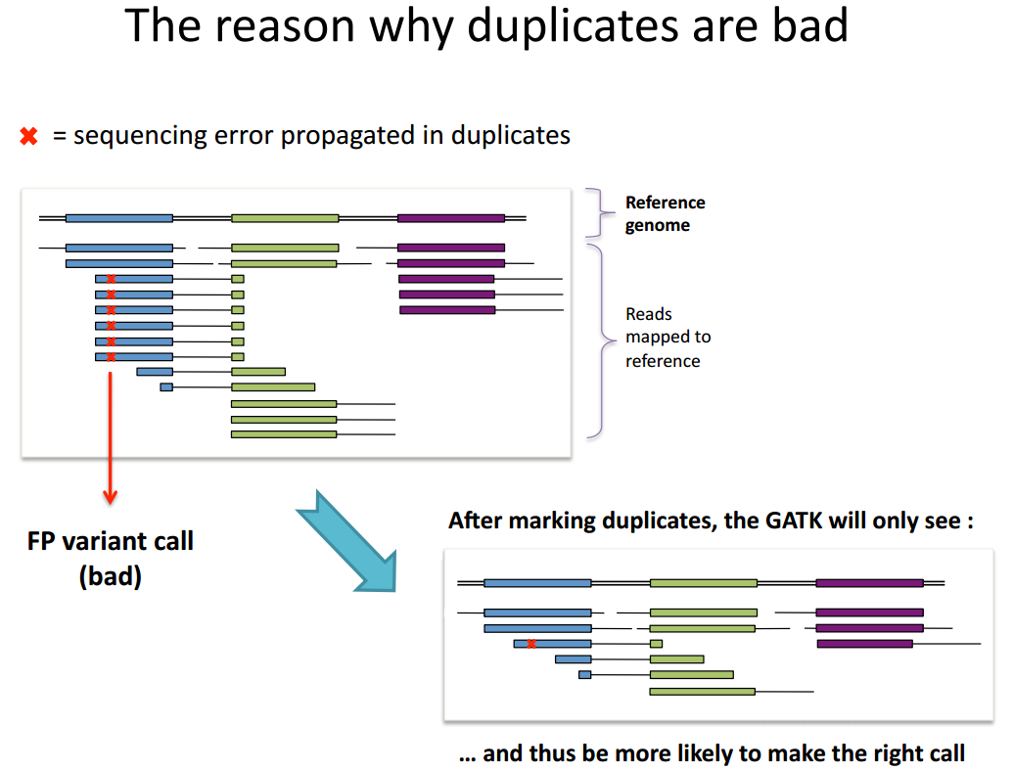

Slide 25
Marking Duplicates
picard
Why wouldn’t you do this for rad-tags?
$ java -jar MarkDuplicates.jar \
INPUT=in.bam \
OUTPUT=out.bam \
METRICS_FILE=out.txt \
ASSUME_SORTED=true
http://picard.sourceforge.net/command-line-overview.shtml#MarkDuplicates

Slide 26
Variant Calling
samtools:
$ samtools mpileup -DISuf ref.fasta \
*.bam | bcftools view -vg - \
> raw_calls.vcf
http://samtools.sourceforge.net/mpileup.shtml

Slide 27
Manipulating Variants
vcftools
$ vcftools --vcf in.vcf --freq --het \
--hardy --site-pi –keep indivs.txt \
--out test
http://vcftools.sourceforge.net/

Slide 28
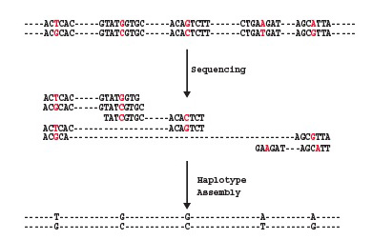
Phasing
samtools?
HAPCUT?
$ extractHAIRS --bam in.bamn --VCF in.vcf \ --ref ref.fa > sample.fragments
$ HAPCUT --VCF in.vcf \
--fragments sample.fragments \
--output phased.txt > hapcut.log
https://sites.google.com/site/vibansal/software/hapcut
doi: 10.1093/bioinformatics/btn298

Slide 29

Rad-Tag Data
In-silico double digestion
restrict -> python
restrict \
-sequence /home/ben/projects/galap_tort/ref_v7/lgv7.fasta \
-sitelen 4 \
-name yes \
-enzymes 'NlaIII,MluCI' \
-outfile ddRad_NlaIII_MluCI

Slide 30
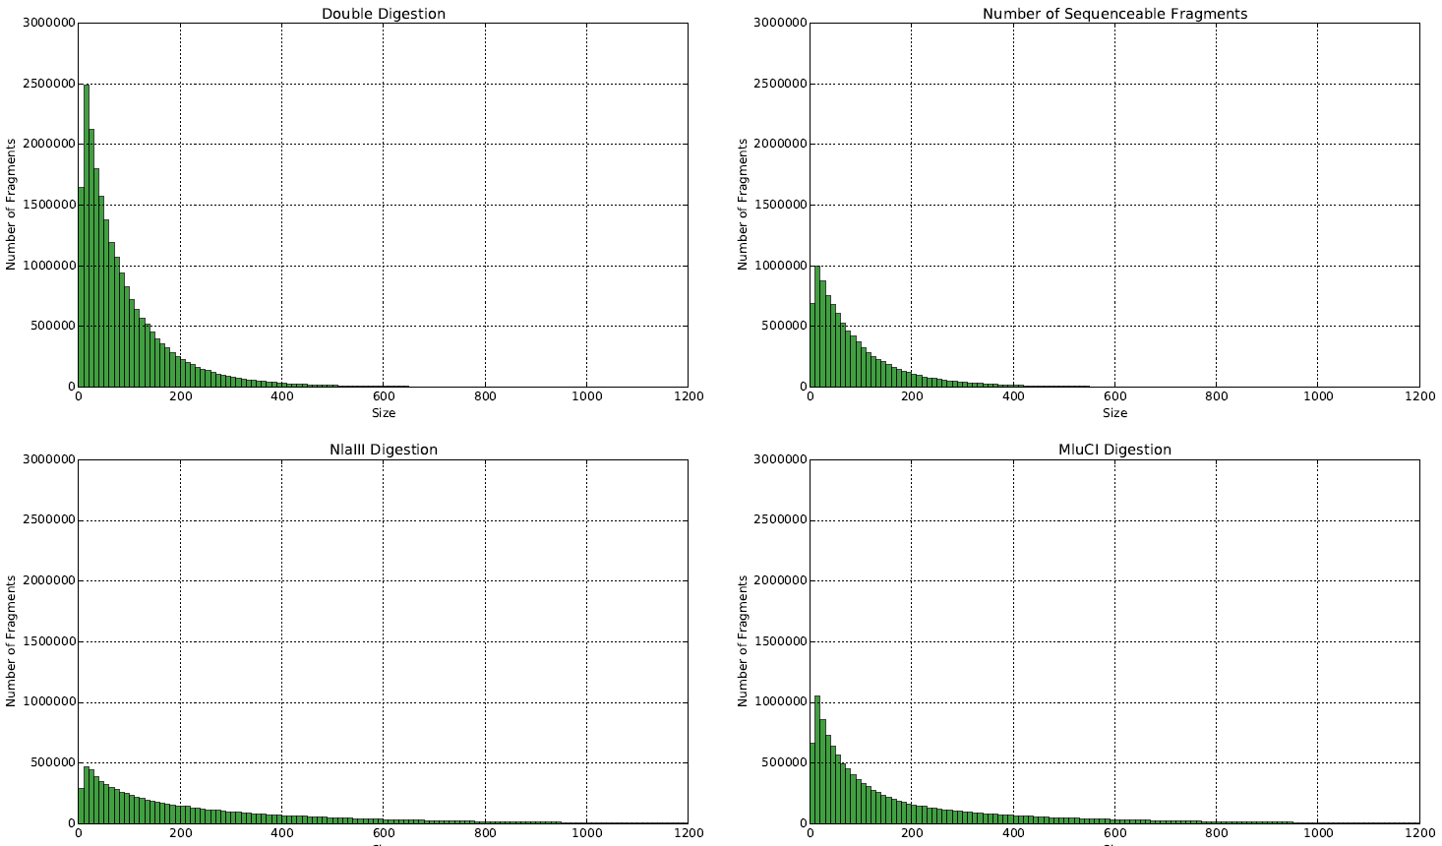
Expected fragments

Slide 31
